Slide 1

Love Memorial manual with you .

Slide 2
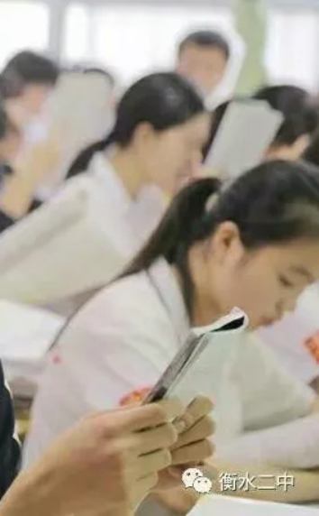
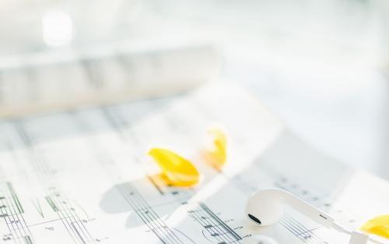
相遇与相识

Slide 3
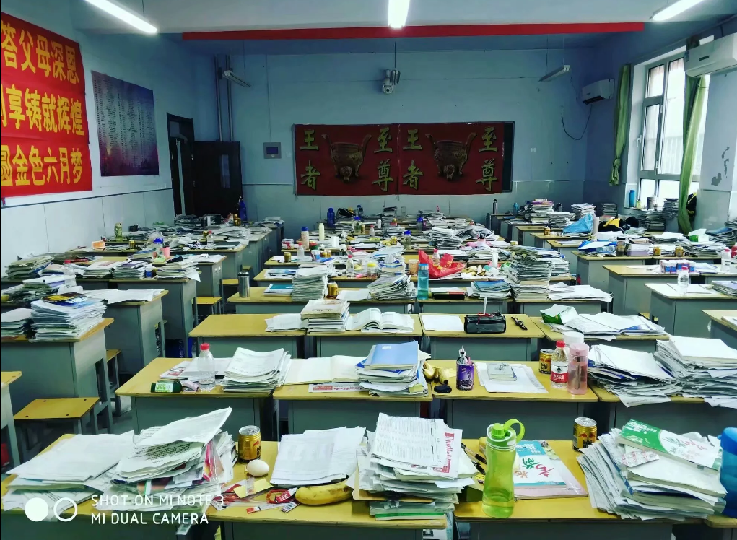
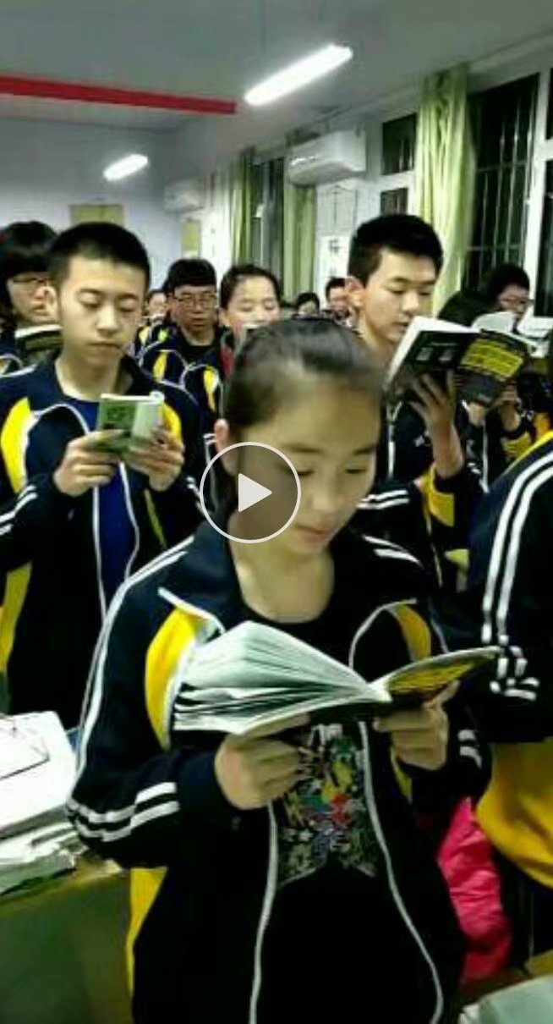
The days we went through together.

Slide 4
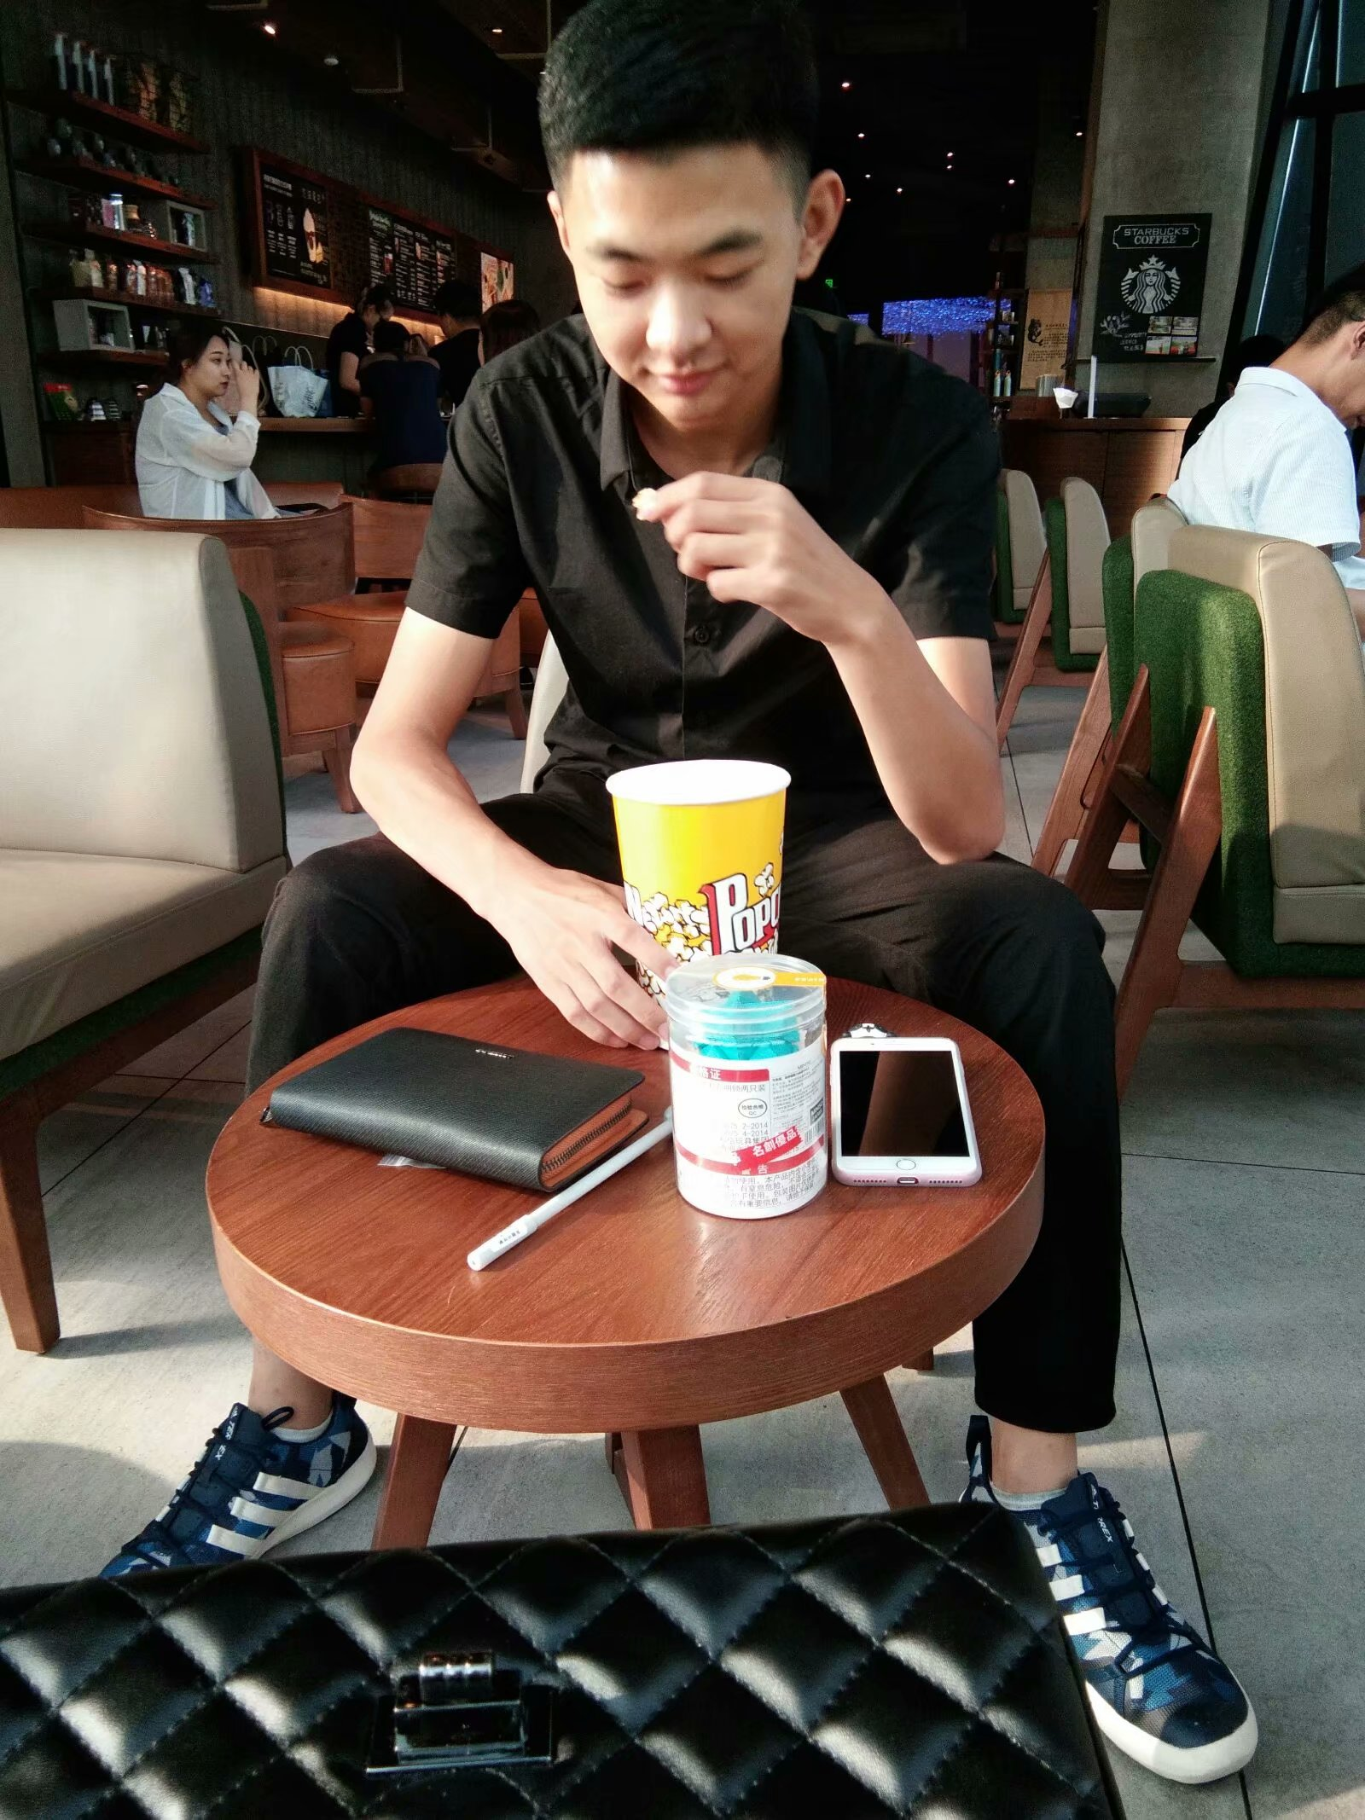
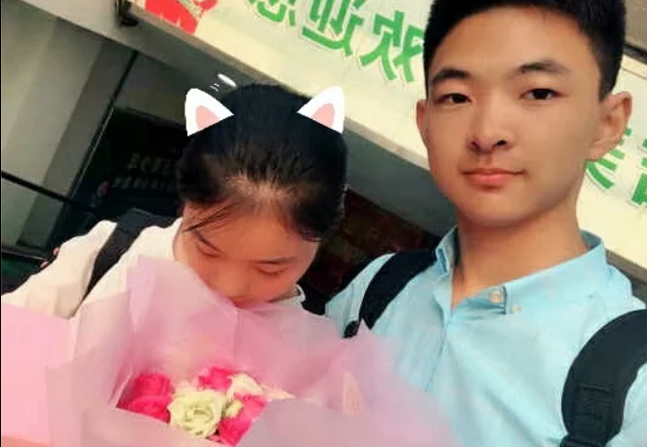
Later…...

Slide 5
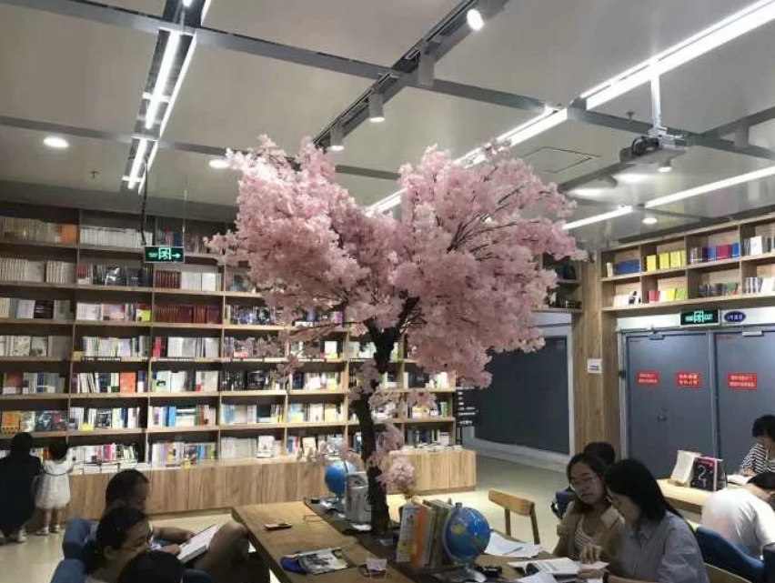
I want to be with the fool forever.

Slide 6
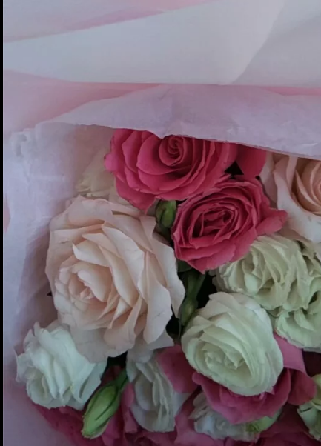
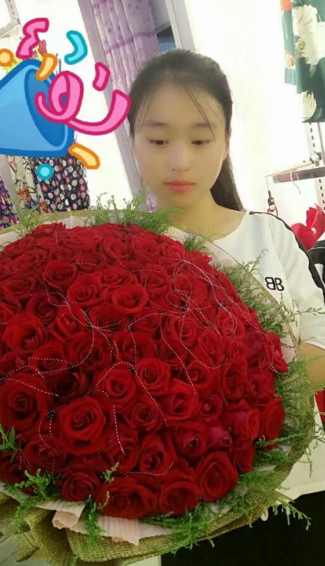
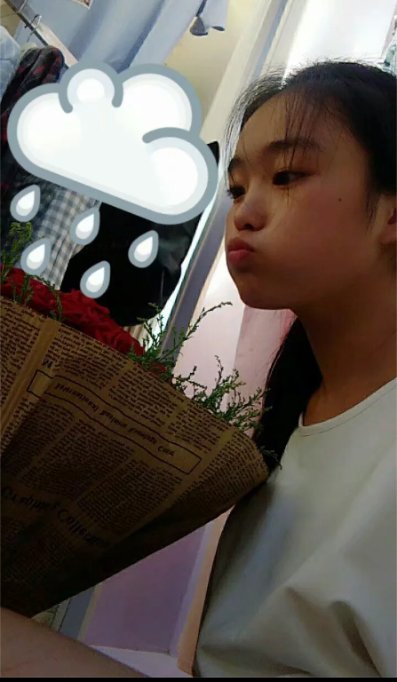
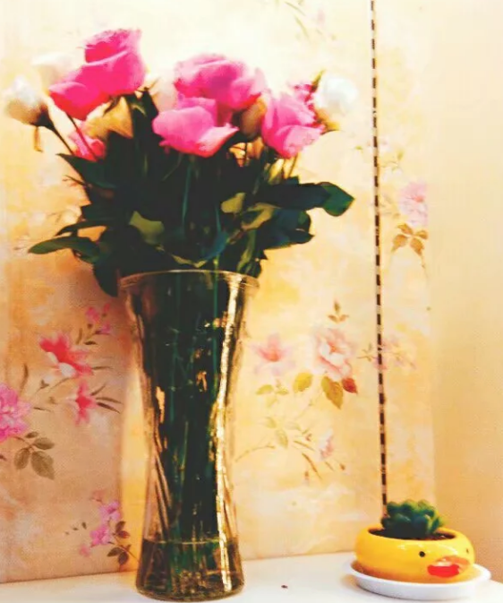
Living with flower

Slide 7

We went to HengShui many times and went to TaiYuan. Every time we watch a movie ,every time you wear a ring for me.

Slide 8
After going through all that together, you become everything to me.
The rest of my life ,I just want you.

